Slide 1

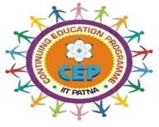
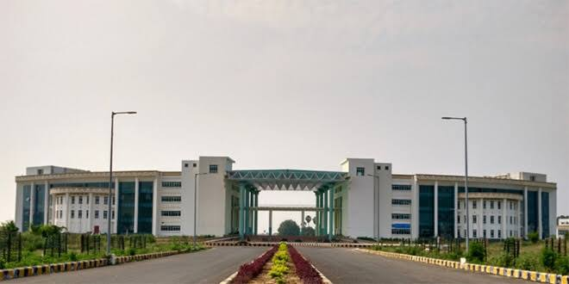
Indian Institute of Technology Patna Department of Electrical Engineering Continuing Education Programme On Modern Trends and Development in Semiconductor Microelectronics (MTDSM) October 09-11, 2020 Coordinators/Resource Persons Dr. Saurabh Kumar Pandey, IIT Patna Dr. Jawar Singh, IIT Patna Important Dates Course dates: October 09-11, 2020 Last date of Registration & Payment: 07th October 2020 Confirmation and Invitation link : 08th October 2020 | Course Description and Content In the last few years, Semiconductor microelectronics have gained immense popularity in the research community. This short course will will provide a forum for reviewing and discussing all aspects of micro and nano-electronics including design, fabrication, characterization and new device technologies. • Microelectronics Technology. • Semiconductor Physics & Modeling. • Basics & Recent developments in Photonics & related devices (LEDs, Photo detectors, etc.). • Wide Band gap Semiconductor Devices. • Current status, recent advances, and next-generation innovations in Photovoltaic Cells. • Sensor basics, advances, and their roles in high-end applications. • Semiconductor Memory Design & applications. Broad Scope The main objective of this course is to provide exposure to the current status and next-generation innovations of various semiconductor devices. The topics will focus on basics, advances, and applications to benefit different people from academic & research communities associated with the disciplines of Electrical, Electronics, Computer Science, Chemistry, Physics, Nanotechnology, etc. Target Audience The course is suitable for fresher’s (UG/PG including Ph.D. students), Scientists in R&D organizations, Faculty Members, and professionals interested in the area of optoelectronics devices and semiconductor technology for advance potential applications. | Fee Payment The participation fees Rs 750/- for the CEP will be accepted only through e-transfer /RTGS/NEFT. Details for Online Payments: Name of the Account: Registrar, IIT Patna Bank: State Bank of India, Branch: IIT Patna, Bihta https://www.onlinesbi.com/sbicollect/icollecthome.htm?corpID=1968961 CEP 23-MTDSM Registration Link https://docs.google.com/forms/d/1Ci-fDWKUD-MrmH7_Mgjk48PoB87Zp3NfliGKnbPuQd8 registration, make the online payment as registration form requires the screen shot of online payment, date, and reference number An Electronic Certificate of participation from IIT Patna will be awarded to all participants after successful completion of the course. For any query please write to: saurabh@iitp.ac.in, jawar@iitp.ac.in

