Slide 1

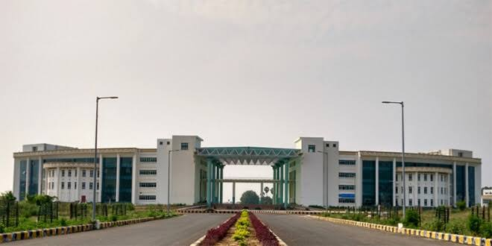
Indian Institute of Technology Patna Department of Electrical Engineering Faculty Development Programme On Entrepreneurship Skill Development (22 November-03 December, 2023), Online Mode Coordinators Dr. Saurabh Kumar Pandey, IIT Patna Dr. Udit Satija, IIT Patna Important Dates Course dates: 22 Nov.-03 Dec. 2023 Last date of Registration & Payment: 20th Nov. 2023 Confirmation and Invitation link : 21st Nov. 2023 About: The Department of Electrical Engineering, Indian Institute of Technology Patna is organizing an DST Sponsored Online Faculty Development Program (FDP) on Entrepreneurship Skill Development from 22 Nov.-03 Dec. 2023. | Course Description The proposed Faculty Development Programme FDP aims at equipping teachers/trainers with skills and knowledge that are essential for inculcating entrepreneurial values in students, guiding and monitoring their progress towards entrepreneurial career. This FDP will benefit up to 50 Teachers of Science Technology Colleges/Institutions, trainers from organizations engaged in entrepreneurship development through a structured training programme of 2 weeks duration. The sessions will provide inputs on process and practice of entrepreneurship development, communication and inter-personal skills, creativity, problem solving, achievement motivation, resources available and all aspects of entrepreneurship. Training methodology includes case studies, group discussion, simulation exercises, field visits and classroom lectures. Course Objectives The course content is designed for the faculty/ Ph.D./ PG students to motivate them to learn about Entrepreneurship. As a part of this FDP, we hope that the participants will be encouraged to become entrepreneur and they will get answer to their queries and hurdles to start with. A detailed feedback will be taken from all participants for the FDP, regarding their queries and challenges which were not resolved in the due course of the FDP and to discuss a particular topic which they want to include in the next FDP. We will try to follow all participants to their challenges in the current and future journey of entrepreneurship and will incorporate those resolutions. Target Audience The course is suitable for fresher’s (UG/PG including Ph.D. students), Scientists in R&D organizations, Faculty Members, and technical professionals interested in this domain. | Resource Persons Speakers from IITs, IIMs, MSME, Start-up's, CA/CS, young entrepreneurs, Management and Industries only FDP Benefits Current scenario/job opportunities for young professionals. Understanding the skill set required to assess pre-feasibility of project through market survey Prospects of motivation achievement and soft skills development, To develop business plan and to understand legal formalities. Topics Unleashing Entrepreneurship: Present Scenario Entrepreneurship: Importance, Need & Practice Business opportunity Identification: Sources of Information How to Set-up MSME (govt. formalities, rules & regulations etc.) Achievement Motivation: Developing Soft Skills Selecting Potential Entrepreneurs: Rationale for Selection Financial Management in MSME Problem solving & decision making How to assess Pre-feasibility of Project through Market Survey Ecosystem available for promoting Entrepreneurship Stress management session Registration https://www.onlinesbi.sbi/sbicollect/icollecthome.htm?corpID=1968961 (category name is Entrepreneurship workshop) Registration fee is Rs. 750 /- applicable for attending FDP. 50 participants are allowed on a first-come-first-serve-basis. Certificates will be provided after completion of course. After payment participants can register on following link: https://forms.gle/QFj2dGyituX1Ehny8 For any query please contact: saurabh@iitp.ac.in, udit@iitp.ac.in 7321893616, 9460154047

