Slide 1
Tutorial-0
Q1: Give examples of phenomenon in Physics involving Steady Flow? How to formulate the model there? Solve?
Q2: Give examples of phenomenon where process approaches an end point asymptotically?

Slide 2
Steady Flow
Source
Sink

Slide 3
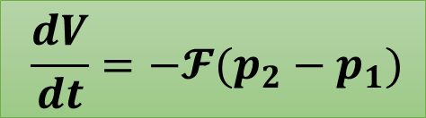
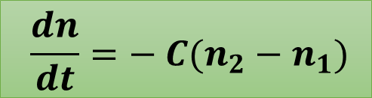

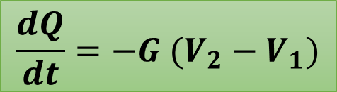
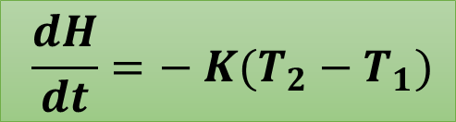
Examples: Steady Flow
$$\frac{dQ}{dt}=−G (V_{2}−V_{1})$$
Electricity
Ohm’s law
$$\frac{dH}{dt}=− K(T_{2}−T_{1})$$
Heat
Fourier’s law
$$\frac{dV}{dt}=−𝓕(p_{2}−p_{1})$$
Hagen-Poiseuille law
Fluid
$$\frac{dn}{dt}=− C(n_{2}−n_{1})$$
Brownian Diffusion
Diffusion
Does this point to an underlying generality of the phenomenon of flowing?
Additional Question: Dimensions of G, K, $𝓕$, C ?

Slide 4
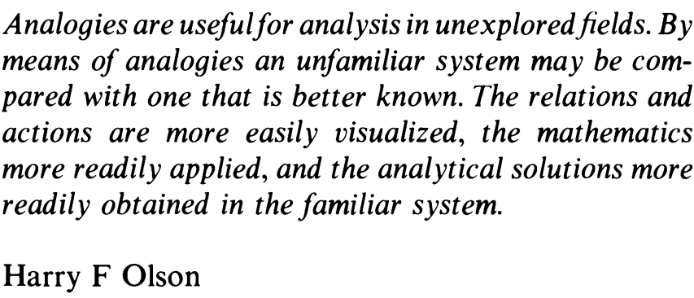

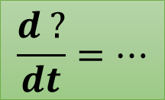



Steady Flow
$$\frac{dQ}{dt}=−G (V_{2}−V_{1})$$
Something which flows
Cause of flow
$$\frac{dH}{dt}=− K(T_{2}−T_{1})$$
$$\frac{dV}{dt}=−𝓕(p_{2}−p_{1})$$
$$\frac{d ?}{dt}=…$$
$$\frac{dn}{dt}=− C(n_{2}−n_{1})$$
Intuition demystified!

Slide 5

The process approaches an end point, asymptotically

Slide 6
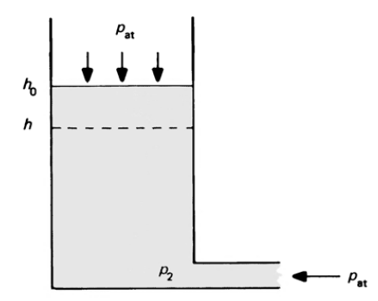
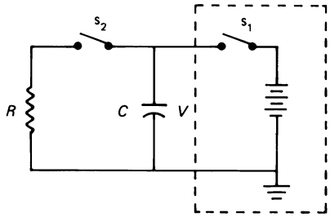
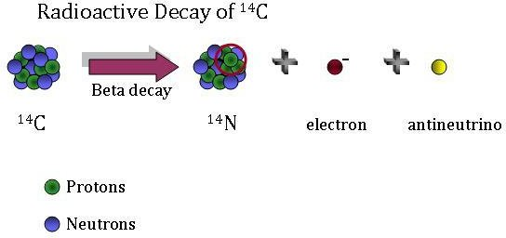
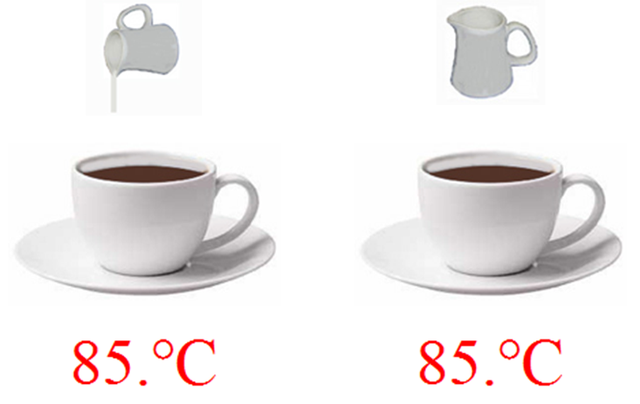
Processes where rate becomes less and less over time
Emptying of a Water Tank
Discharging of a Capacitor
Radioactive Decay
Cooling of a warm object

Slide 7
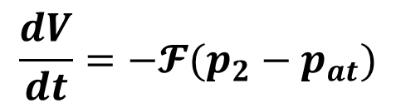
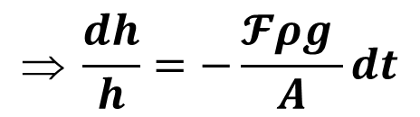
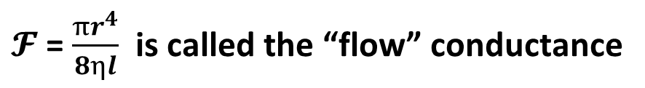


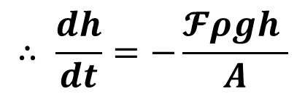
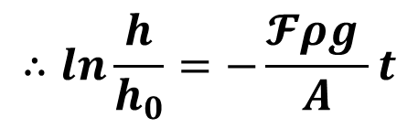
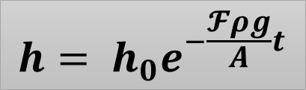

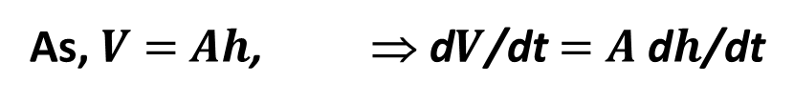

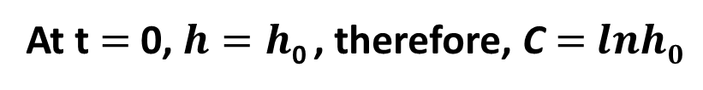
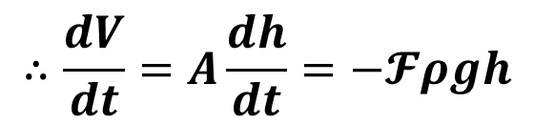


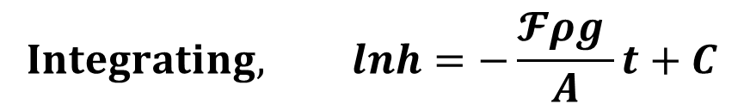
Emptying of a Water Tank
$$p_{at}$$
$$\frac{dV}{dt}=−𝓕(p_{2}−p_{at})$$
$h$₀
$${But, p}_{2}=p_{at}+ρgh$$
$h$
As, $V$ $=$ $Ah$, ⇒ d$V$/dt $=$ $A$ d$h$/dt
$$∴\frac{dV}{dt}=A\frac{dh}{dt}=−𝓕ρgh$$
$$p_{2}$$
$$p_{at}$$
$$∴ \frac{dh}{dt}=−\frac{𝓕ρgh }{A}$$
$$ \frac{dh}{h}=−\frac{𝓕ρg }{A}dt$$
$$Integrating, lnh=−\frac{𝓕ρg }{A}t+C$$
$$∴ln\frac{h}{h_{0}}=−\frac{𝓕ρg }{A}t$$
At t $=$0, $h=h$₀ , therefore, C $=$ $lnh0$
$$h= h_{0}e^{−\frac{𝓕ρg}{A}t}$$
Finally,
$𝓕$ = $\frac{πr^{4}}{8ηl}$ is called the “flow” conductance

Slide 8
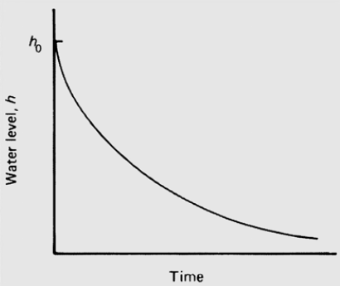
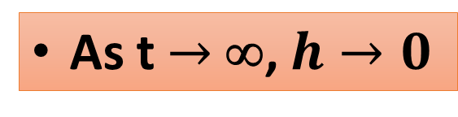
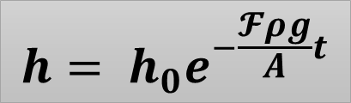

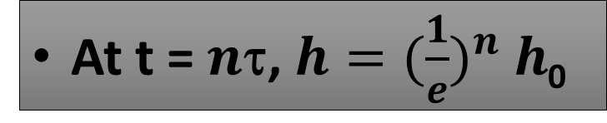


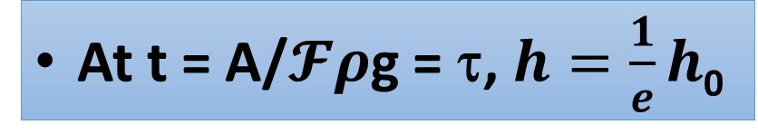
Emptying of a Water Tank
$$p_{at}$$
$$h= h_{0}e^{−\frac{𝓕ρg}{A}t}$$
$h$₀
$h$₀
$h$
Water level, $h$
$$p_{2}$$
$$p_{at}$$
Time, $t$
Exponential Decay
τ : relaxation time
As t $→$∞, $h→0$
Observations
At t = A/$𝓕ρ$g = τ, $h=\frac{1}{e}h$₀
At t = $n$τ, $h={(\frac{1}{e})}^{n} h$₀

Slide 9
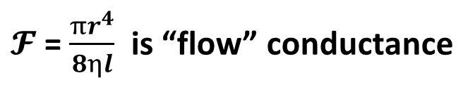
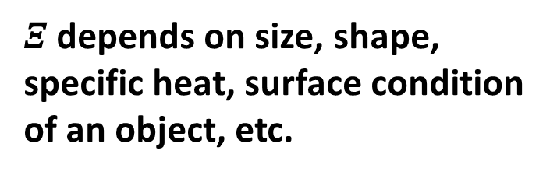
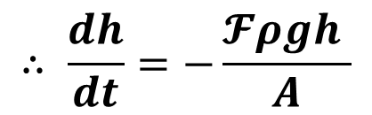
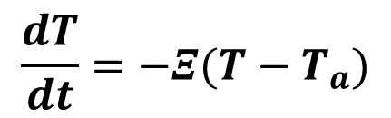
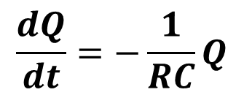
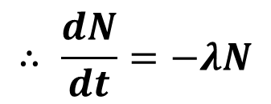
Processes where rate becomes less and less over time
Emptying of a Water Tank
Discharging of a Capacitor
$$∴ \frac{dh}{dt}=−\frac{𝓕ρgh }{A}$$
$$\frac{dQ}{dt}=−\frac{1}{RC}Q$$
$𝓕$ = $\frac{πr^{4}}{8ηl}$ is “flow” conductance
τ = RC discharge time constant
Radioactive Decay
Cooling of a warm object
$$∴ \frac{dN}{dt}=−λN$$
$$\frac{dT}{dt}=−Ξ(T−T_{a})$$
$Ξ$depends on size, shape, specific heat, surface condition of an object, etc.
λ is decay rate
t_{1/2} = λ

